Slide 1
Welcome to
State Level Banker’s Committee
Portal
https://slbconline.bih.nic.in/

Slide 2
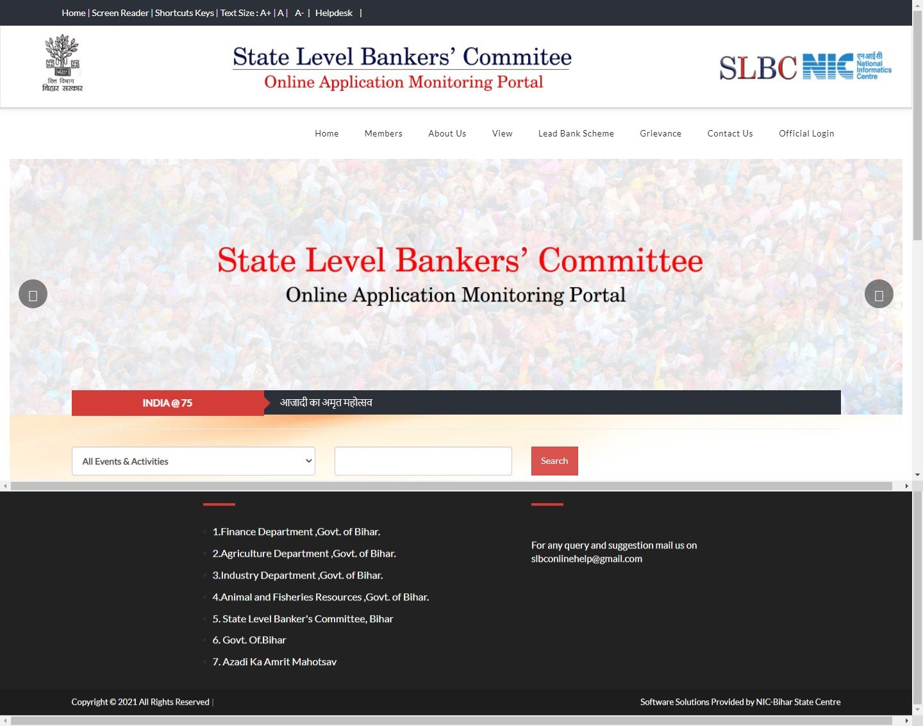
Home Page

Slide 3
Department Admin Login

Slide 4
Add & Edit Scheme

Slide 5
Change Password

Slide 6
District Admin Login (Every Department)

Slide 7
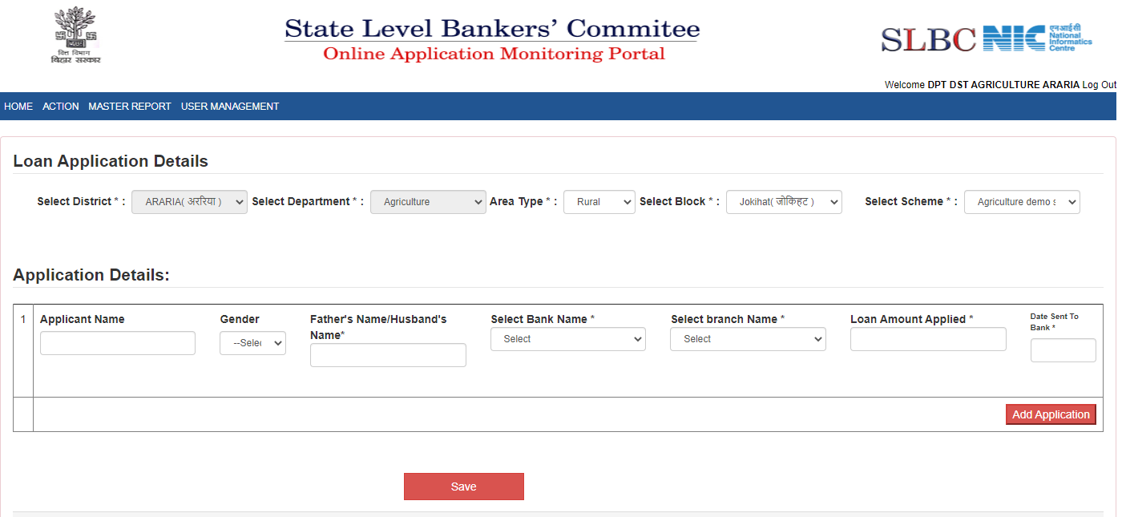
Loan Application For Rular

Slide 8
Loan Application For Urban

Slide 9
Branch Admin Login

Slide 10
Acknowledge Application

Slide 11
Approve Application

Slide 12
Bank Admin Login

Slide 13
Change Password

Slide 14
Admin Login

Slide 15
Add IFSC

Slide 16
Upload Event

Slide 17
Approve Event

Slide 18
Reports

Slide 19
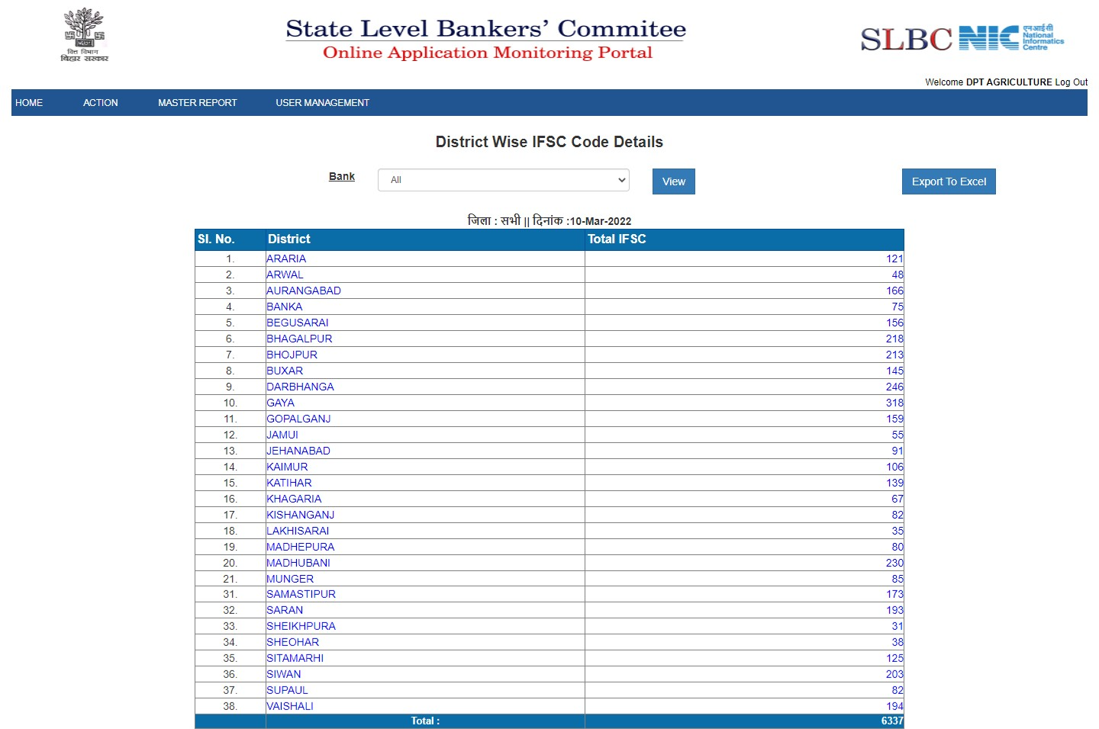
District Wise IFSC Details

Slide 20
Department Wise total application Report

Slide 21
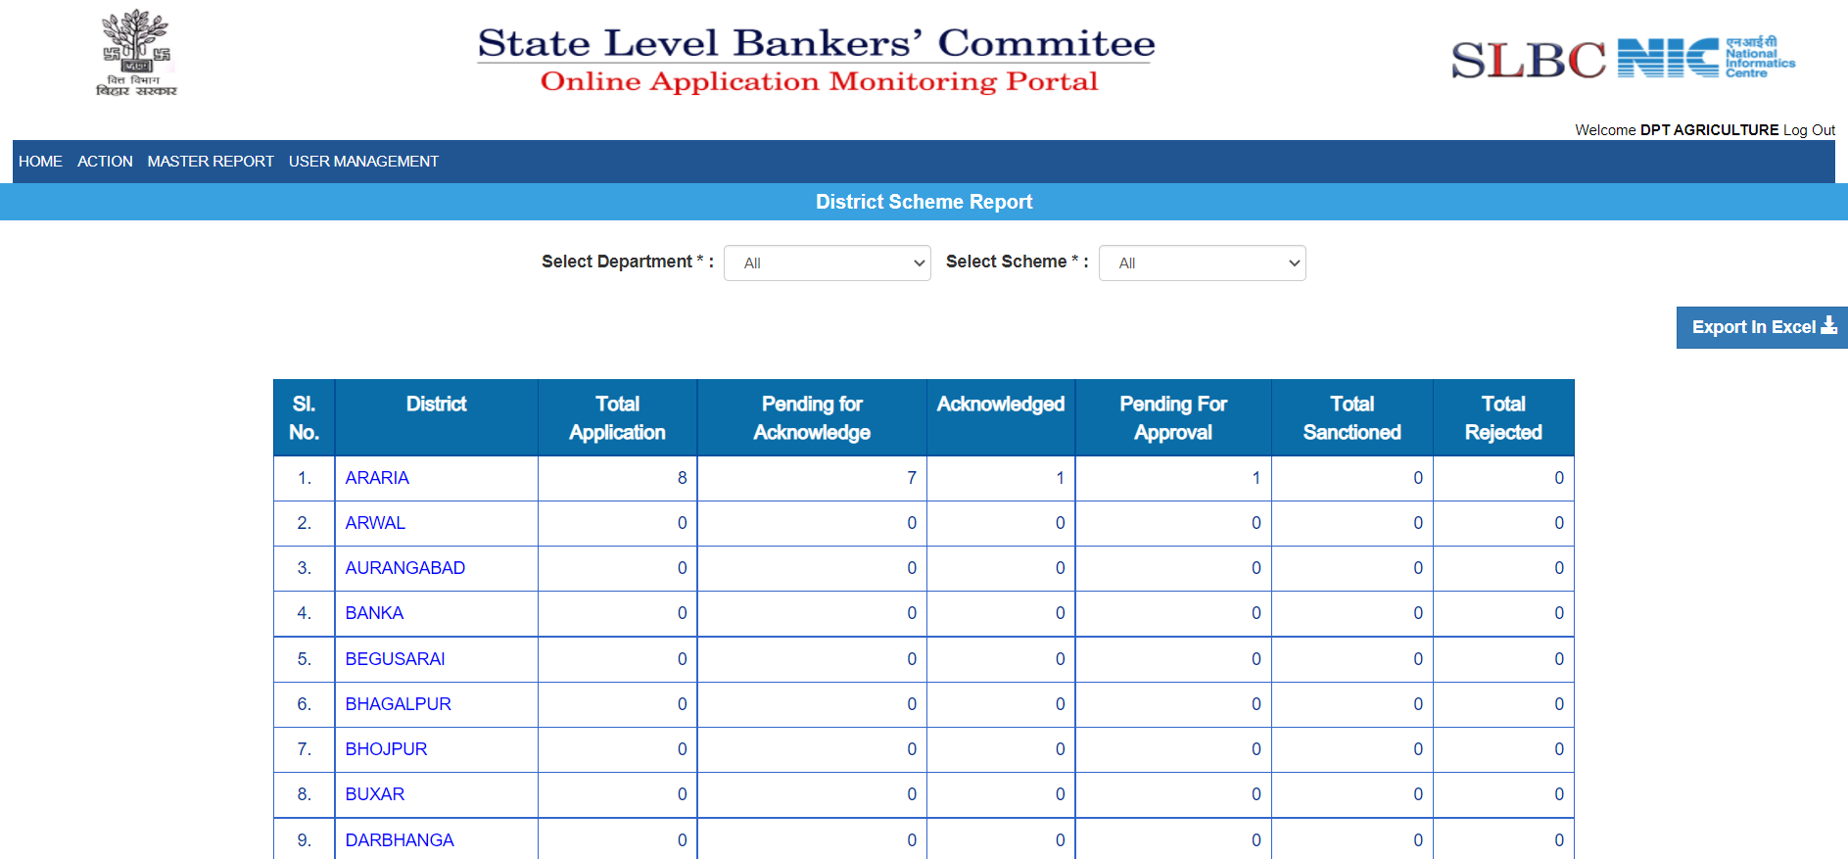
District Wise total application Report

Slide 22
Bank Wise Total Application Report

Slide 23
District Scheme Wise Total Application Report

Slide 24
Bank Scheme Wise Total Application Report

Slide 25
Thank You

